Slide 1
Humanitarian Relief Distribution Game
Sinan Salman, PhD
Suzan Alaswad, PhD
Zayed University
UNHCR: 65.6 million forcibly displaced people in the world in 2018. Photo: AFP
Debrief
Notes:
Note: Some of the material used here is based on slides by Dr. Kai Riemer, http://www.beergame.org

Slide 2
Player Experience
How did you feel?
Calm, Collected, In Control?
Or did you feel a little overwhelmed, frustrated and controlled by forces in the system?
Did you find yourself "blaming" the players next to you for your problems?
How was the supply chain performance?

Slide 3
Performance
Team performance is always poor
30%-60% fulfillment rate
Average costs are about $500K-$6M (for 45 weeks)
Best possible performance
95+% fulfillment rate
10 folds improvement in cost!
Similar patterns always occur… even though very different people play

Slide 4
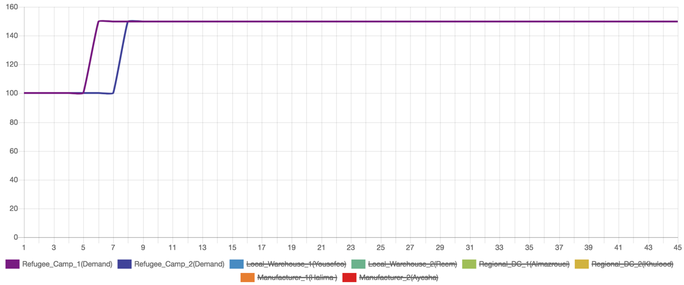
Was Volatile Customer Demand the Problem?

Slide 5
Management Focus
Which of the performance metrics did you focus on?
Fulfillment rate
Cost
Environmental impact

Slide 6
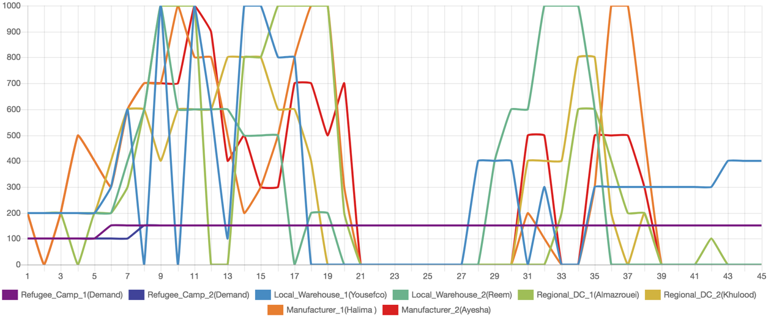
Typical Results Orders

Slide 7
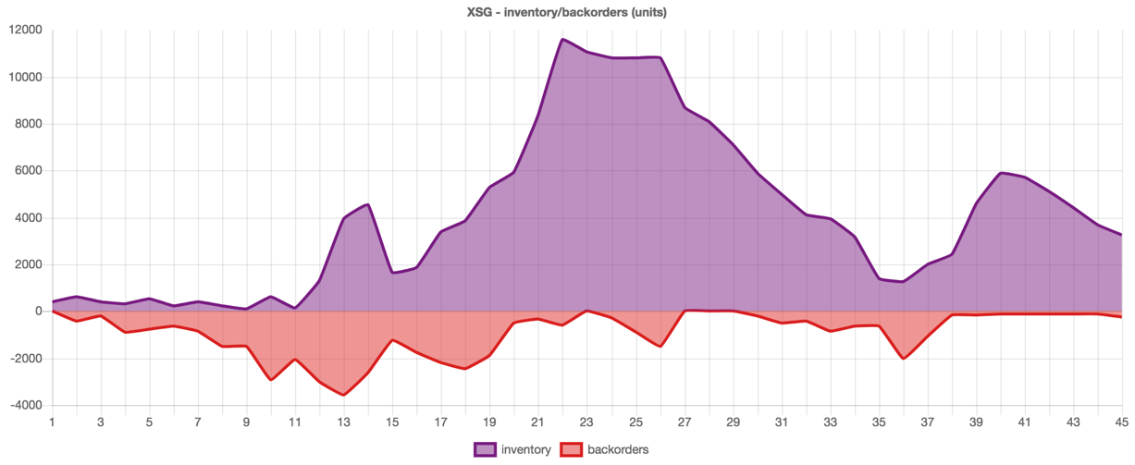
Typical Results Inventory/Backorders

Slide 8
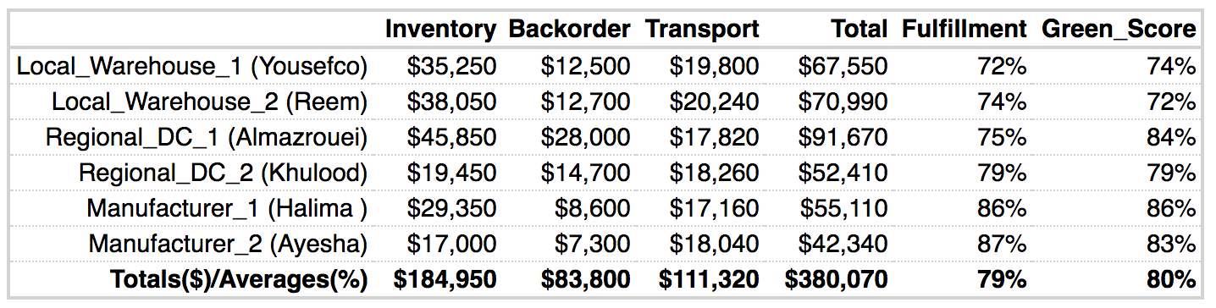
Typical Results

Slide 9
Other Groups

Slide 10
What would happen in the real world with this kind of performance?
A typical organizational response would be to find the "person responsible" (usually the guy/gal placing the orders or the inventory manager) and blame him/her
But the game clearly demonstrates how inappropriate this response is

Slide 11
Some questions for discussion
What, if anything, is unrealistic about this game?
Why are there order/production/shipping delays?

Slide 12
Bullwhip effect → problems
High inventory levels
Low service level (backorders)
High cost
High demand fluctuation causes more problems…

Slide 13
Bullwhip effect → problems
Variation in demand along the supply chain requires…
Shipment capacity
Production capacity
Inventory capacity
to cope with peaks.
Most of the time this capacity will be idle.
There’s significant cost and investments attached!
In the end: high overall cost in the supply chain

Slide 14
Report
Factors contributing to supply chain performance
Lack of information flow
Lack of demand forecasting
Long lead time
Ordering policies: Batching and Shortage Gaming
Price fluctuation (e.g. promotions, discounts, and sales), does it impact bullwhip? If so how?
Triple bottom line objective
Supply chain design (could direct to customer instead of the utilized distribution channels help?)
If you only can change one thing in the simulation to significantly improve performance, what would you do?

Slide 15
Debrief End

